Slide 1
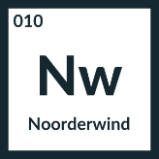

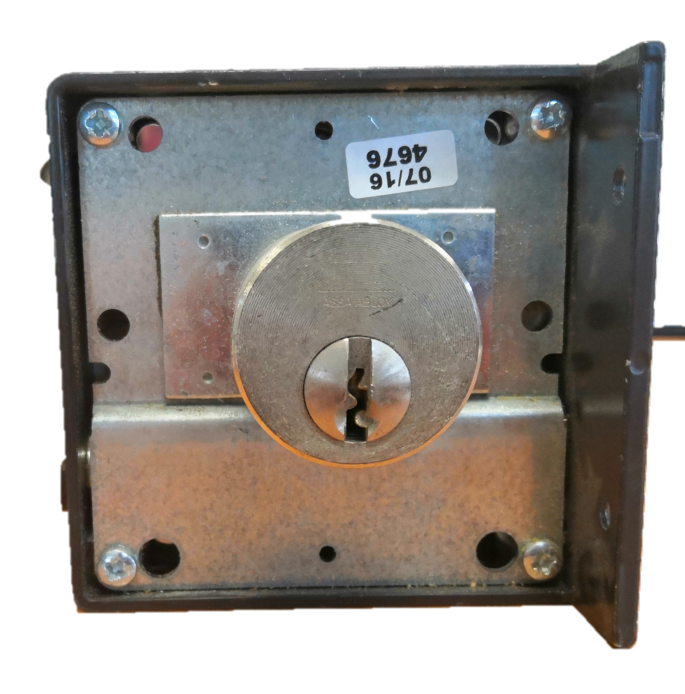
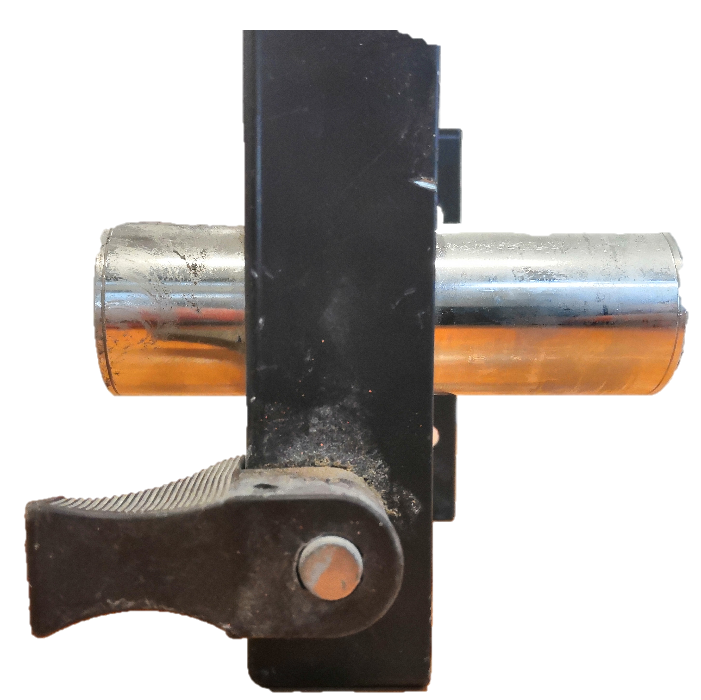
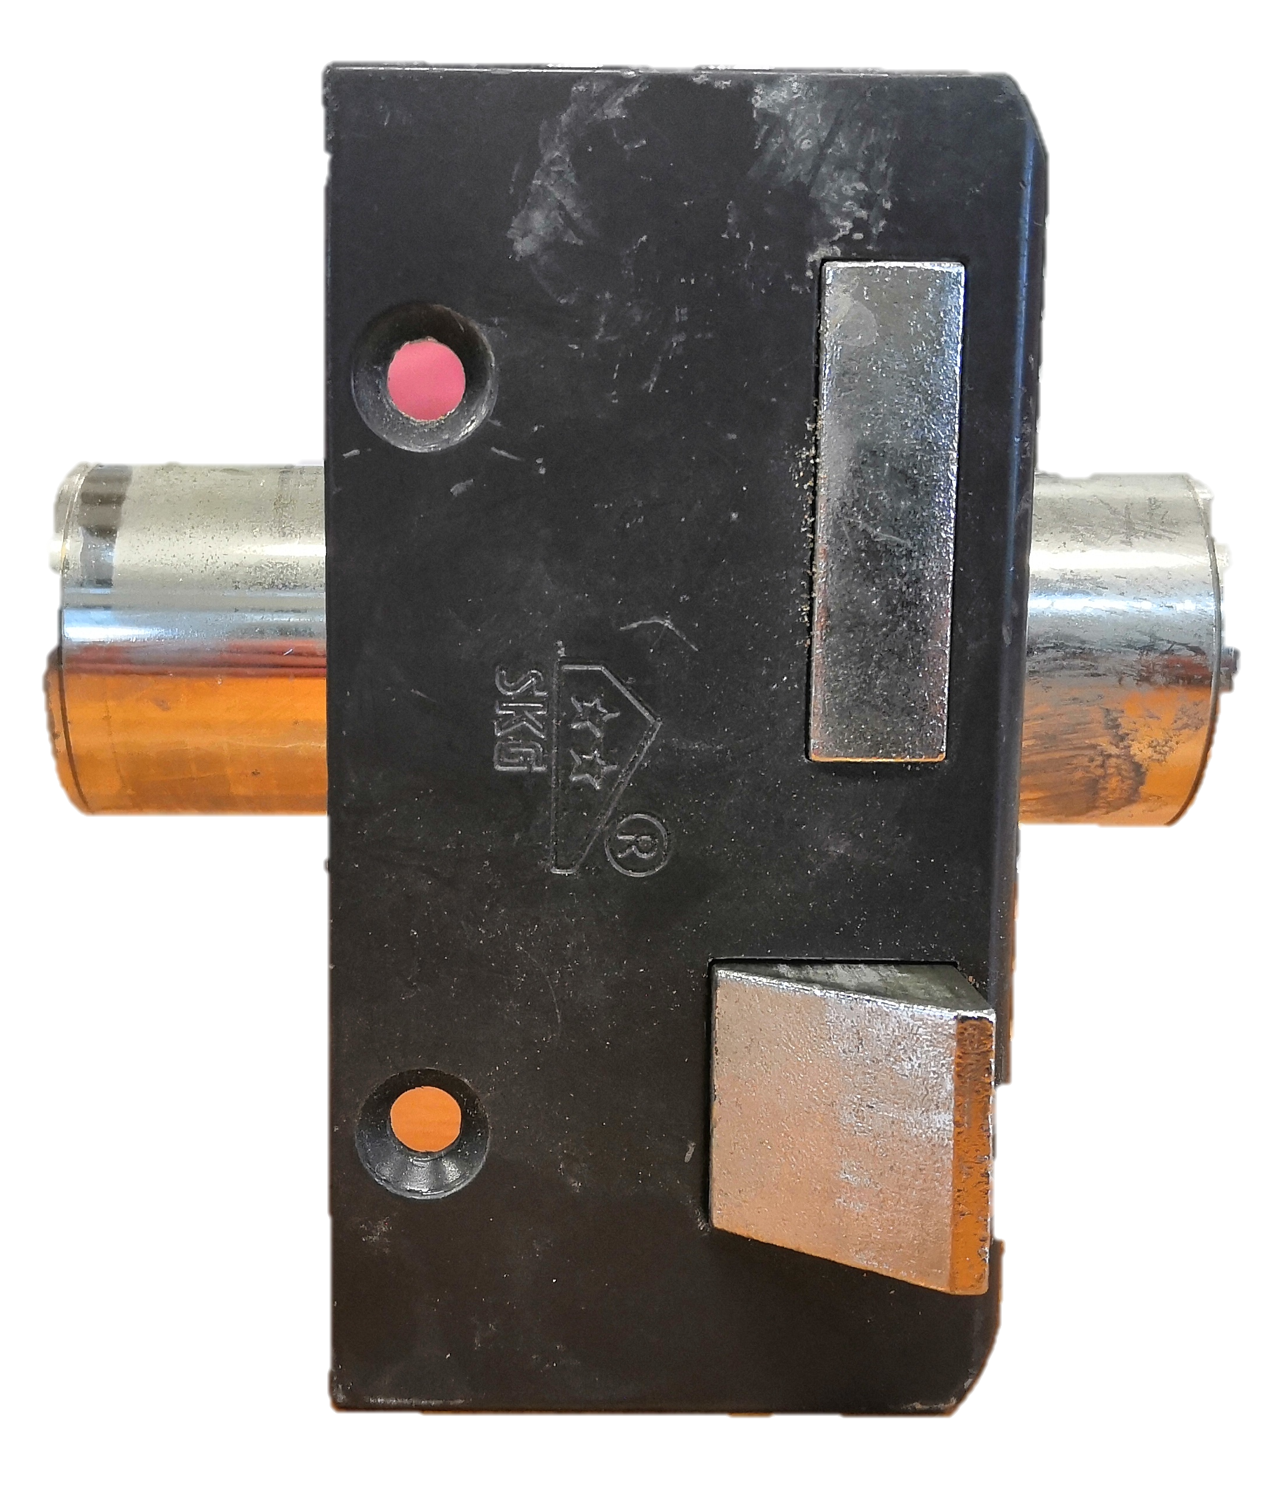
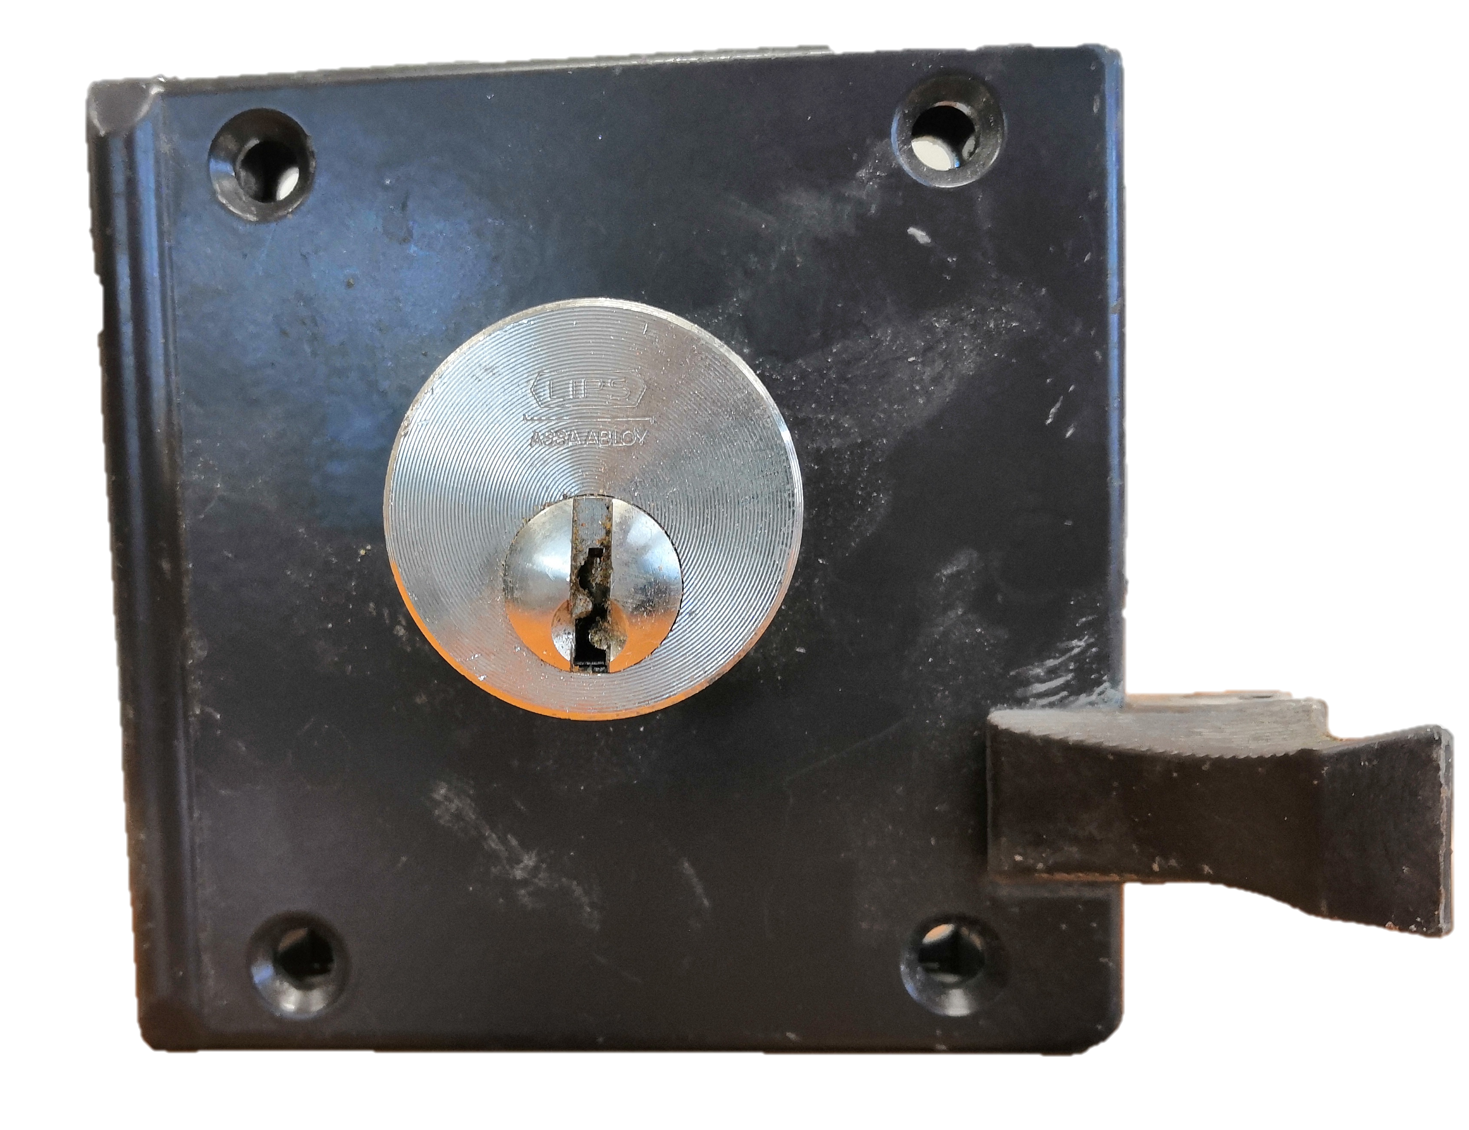



Material Passport - Assembly
No | Name part | Raw material (s) | Mass (gram) | Qty | Total mass (gram) | Remarks
1 | Lock Cilinder | Steel | 143,0 | 1
2 | Plate | Steel | 148,0 | 1
3 | Bolt | Aluminium alloy | 96,0 | 1
4 | Spring | Unknown | 2,0 | 1
5 | Lock remove | Aluminium | 13,0 | 1
6 | Cilinder | Steel | 48,0 | 1,5
Assembly: Door Lock
Total weight: 1190,0 gram
Amount of unique parts:
Amount of total parts:
Drawing of exploded view:
Who were involved in the production of these parts?
unknown
Who were involved in the production of the assembly?
unkown
Any particularities?
This work is licensed under the Creative Commons Attribution-Share Alike 3.0 Unported License

Slide 2
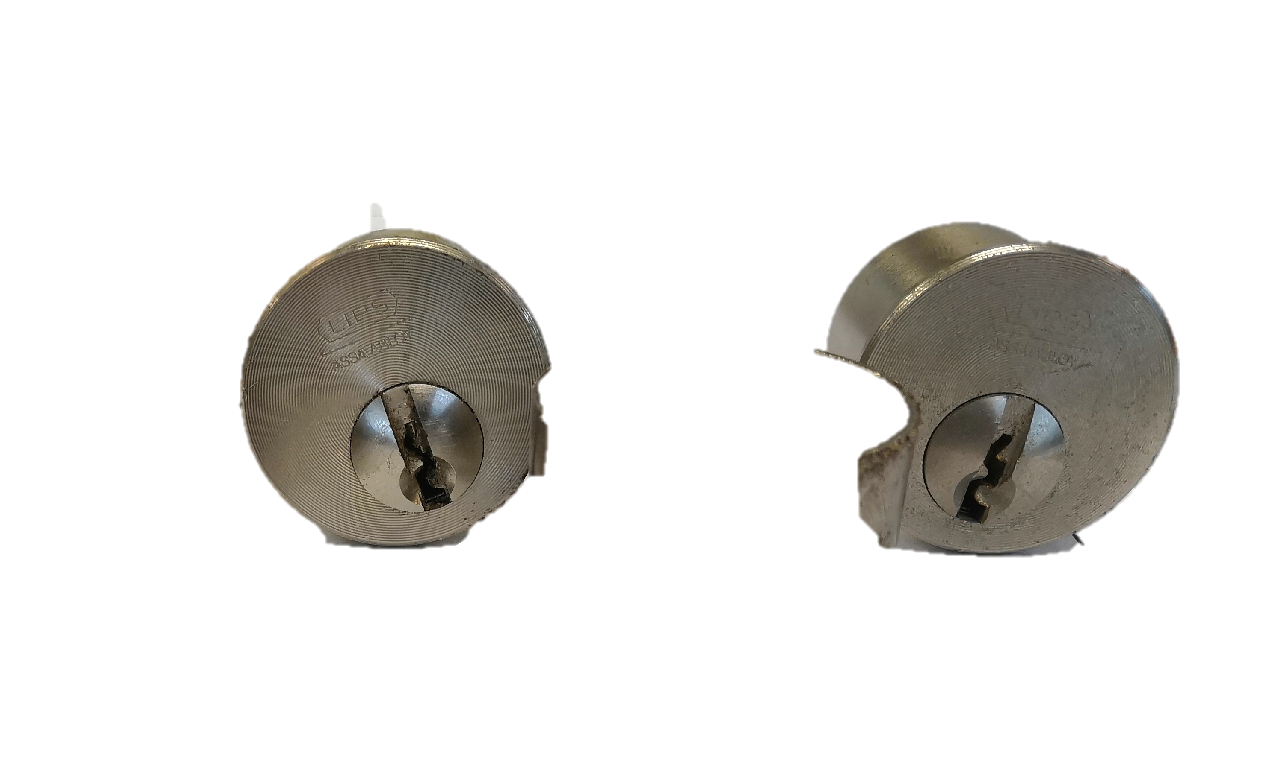
Material Passport - Part
Material properties
Part: Lock Cilinder
How does it feel? Heavy for its size.
From assembly: Door Lock
Mass: 143.0
How does it smell? It has no particular smell.
Material(s):
What is the finishing? (paint, coating) A coating for shine and smooth operation
Value (emotional): Gives a feeling of safety.
Draw part (or cross-section):
What is the (emotional) value? A very high safety value
Any specifications on the material? (code, location) Lipo, Assa, Abloy
Where did the raw material come from?
What are the characteristics? (water/heat/UV/salt resistance) The metal in de lock is heat conductive and is operable in all kinds op circumstances.
Yes
No
Is there a risk in reusing/working with the material?
If yes, what is the risk?
Material uniqueness
What are the unique technical/experimental qualities to be emphasized in the final application? It can lock different thing in place
In what context would the material make the most positive difference? When it can be used to close off or open up doors, cabinets, sheds, etc.
How would the material then be sensed and interpreted by the users?
As old stuff, so maybe we need to upcreate this.
How is the part processed at the end of its lifetime? What are the costs?
Are there any more particularities? ………………………………………………………….
Some questions are based on Material Driven Design (MDD): A Method to Design for Material Experiences by Elvin Karana
This work is licensed under the Creative Commons Attribution-Share Alike 3.0 Unported License

Slide 3
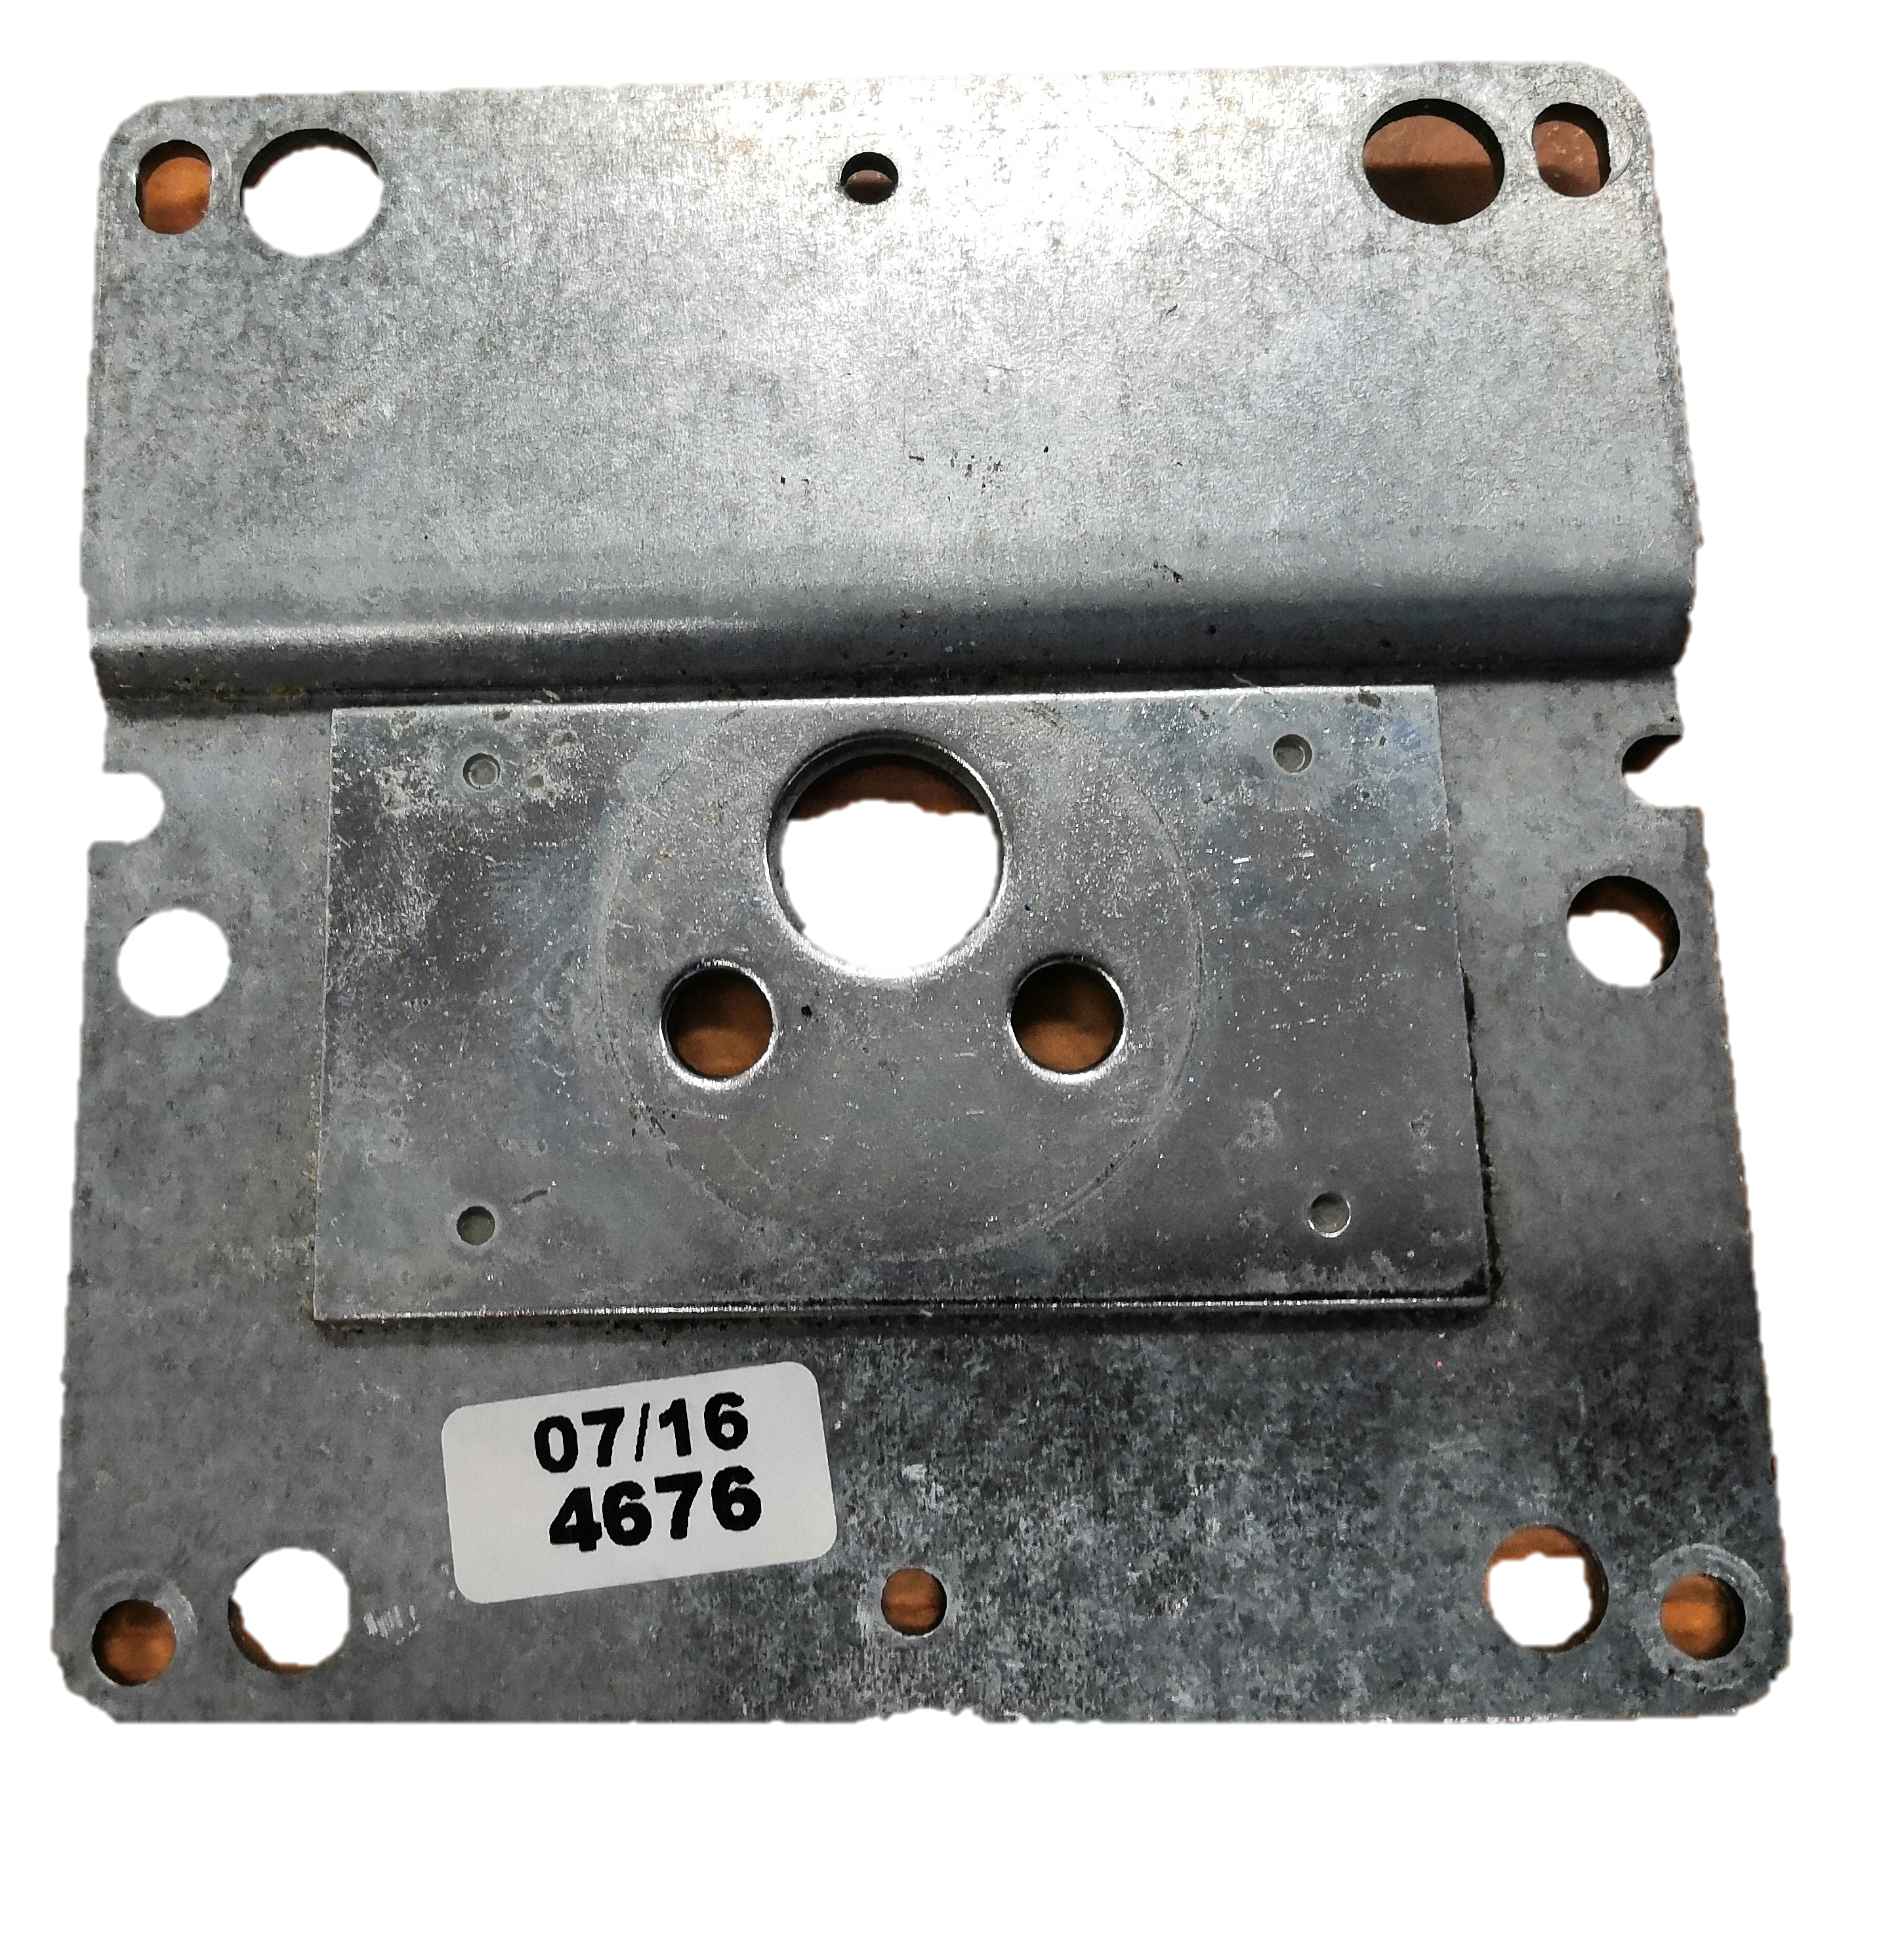
Material Passport - Part
Material properties
Part: Plate
How does it feel? It feels heavy and sturdy.
From assembly: Door Lock
Mass:148.0 gram
How does it smell? Oilly, metallic
Material(s): probably stainless steel
What is the finishing? (paint, coating) It looks polished.
Value (emotional): It has a lot of mounting options and is not entirely straight.
Draw part (or cross-section):
What is the (emotional) value? It keeps the housing of a lock together
Any specifications on the material? (code, location) On the backside there is a sticker with the code: 07/16 (date?) 4676
Where did the raw material come from? ...……………………………….……………... ………………………………………………………………………………………………………………...
What are the characteristics? (water/heat/UV/salt resistance) Metal has a high electric and heat conductivity.
Yes
No
Is there a risk in reusing/working with the material?
If yes, what is the risk?
Material uniqueness
What are the unique technical/experimental qualities to be emphasized in the final application? How strong is the material? Is it meltable for reuse? Can it be used to hang simple home applications?
In what context would the material make the most positive difference? By reusing it as it is, that we don’t have to put more energy in this part.
How would the material then be sensed and interpreted by the users?
Probably as a mounting bracket of some sorts.
How is the part processed at the end of its lifetime? What are the costs?
Are there any more particularities? It is nog flat, but slightly curved. The center is reinforced.
Some questions are based on Material Driven Design (MDD): A Method to Design for Material Experiences by Elvin Karana
This work is licensed under the Creative Commons Attribution-Share Alike 3.0 Unported License

Slide 4
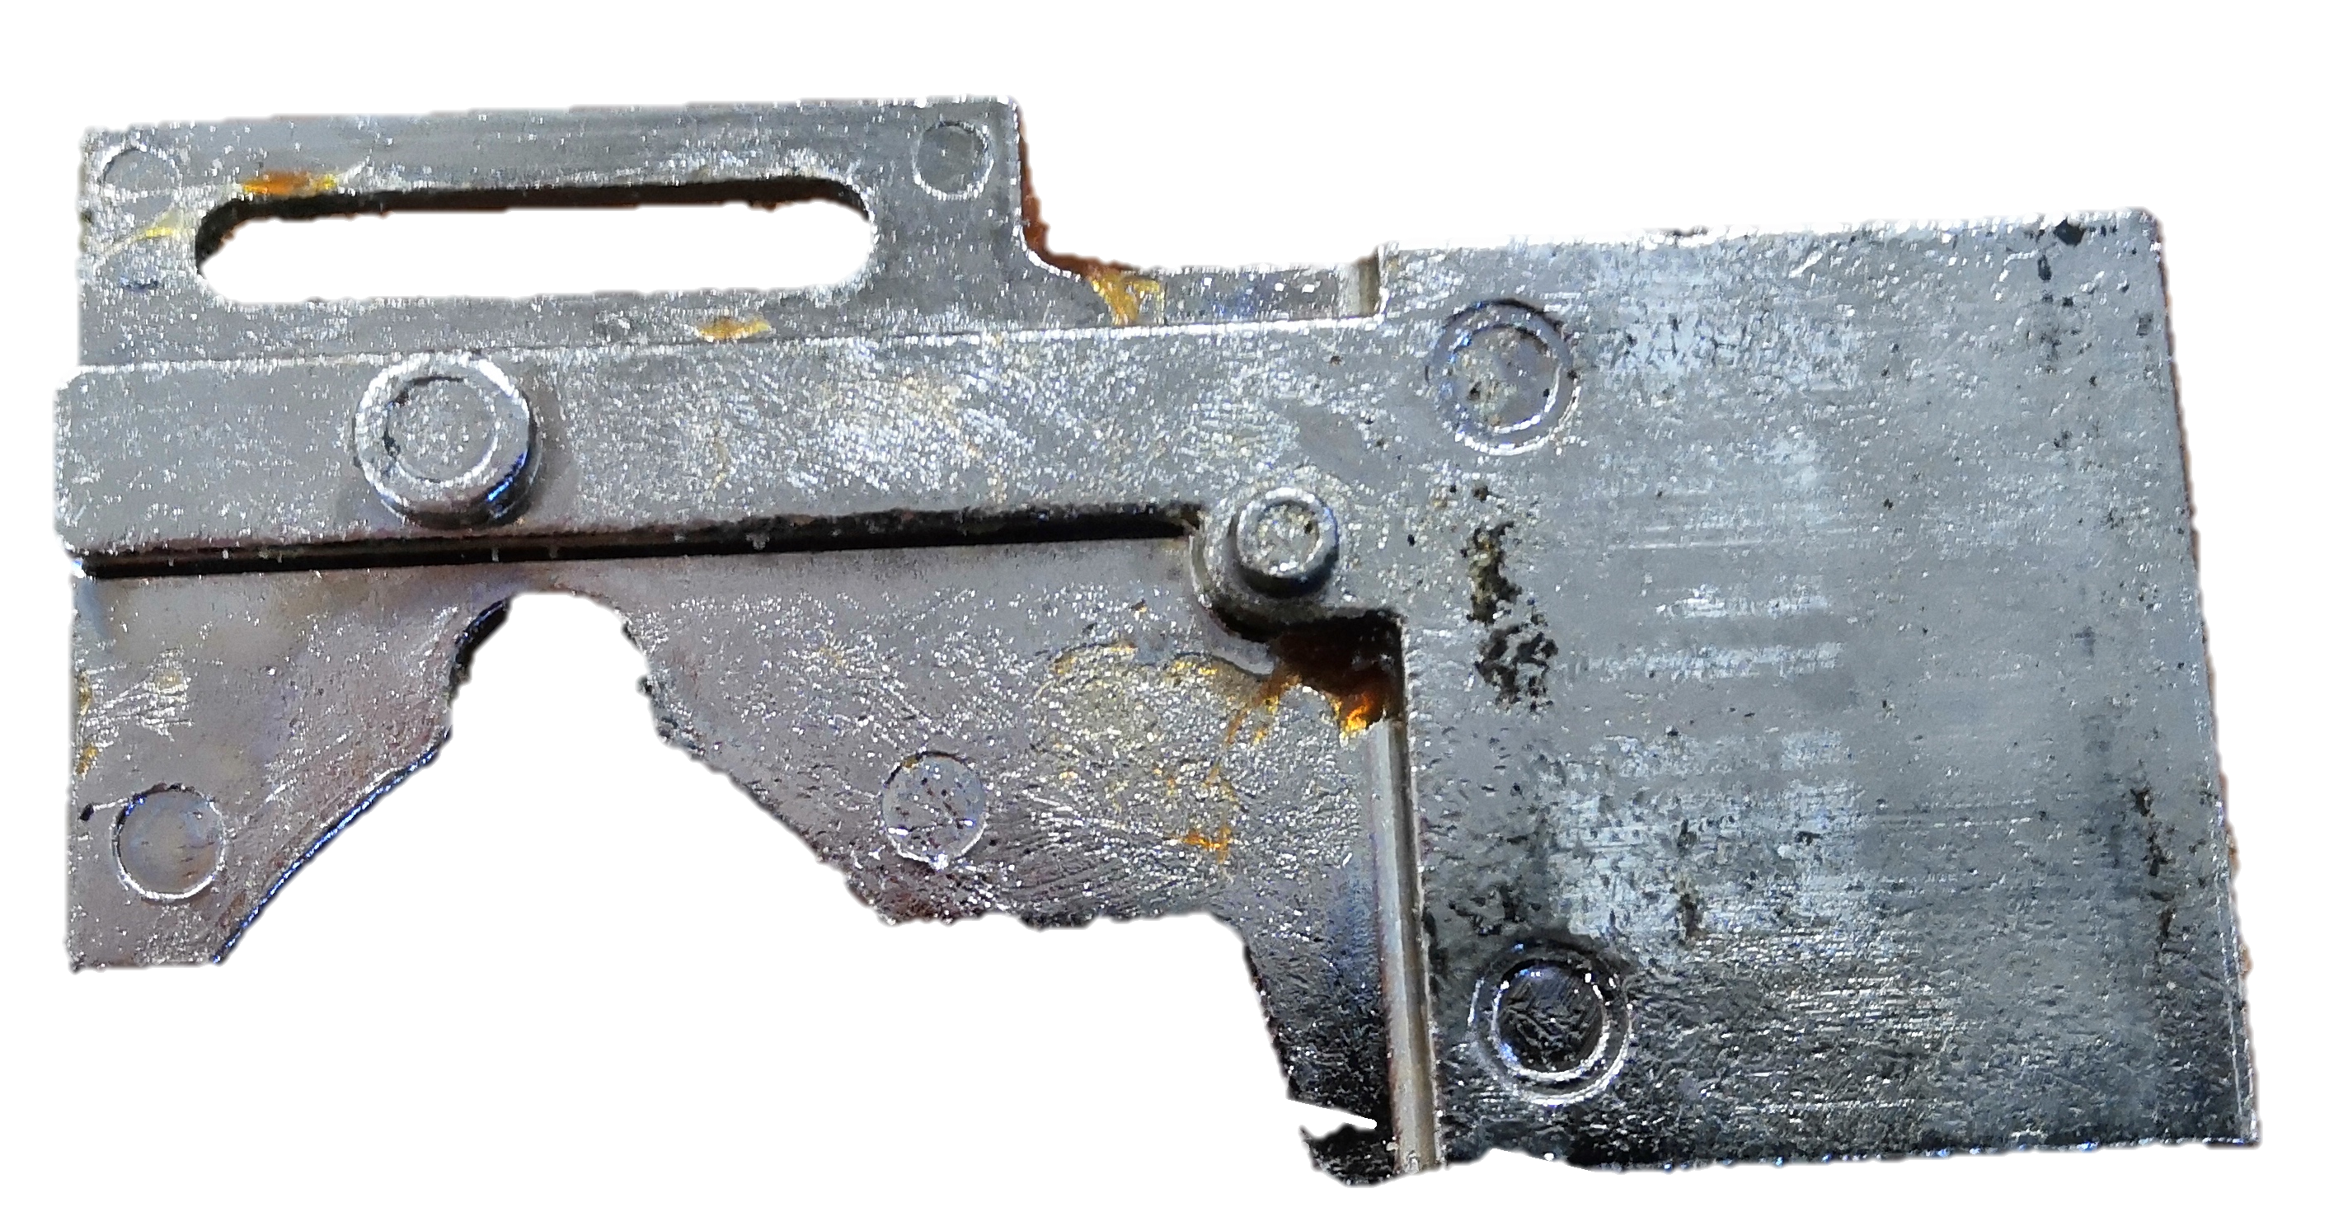
Material Passport - Part
Material properties
Part: Bolt
How does it feel? Lightweight
From assembly: Door Lock
Mass: 96 grams
How does it smell? Metal and oil.
Material(s): Aluminium Alloy
What is the finishing? (paint, coating) It looks polished.
Value (emotional):
What is the (emotional) value?
Draw part (or cross-section):
Any specifications on the material? (code, location)
Where did the raw material come from? ...……………………………….……………... ………………………………………………………………………………………………………………...
What are the characteristics? (water/heat/UV/salt resistance) It has de properties of metal. Highly conductive of electricity and heat.
Yes
No
Is there a risk in reusing/working with the material?
If yes, what is the risk?
Material uniqueness
What are the unique technical/experimental qualities to be emphasized in the final application?
In what context would the material make the most positive difference? It’s odd shape could provide a form of aesthetic feeling.
How is the part processed at the end of its lifetime? What are the costs?
How would the material then be sensed and interpreted by the users?
Are there any more particularities?
Some questions are based on Material Driven Design (MDD): A Method to Design for Material Experiences by Elvin Karana
This work is licensed under the Creative Commons Attribution-Share Alike 3.0 Unported License

Slide 5
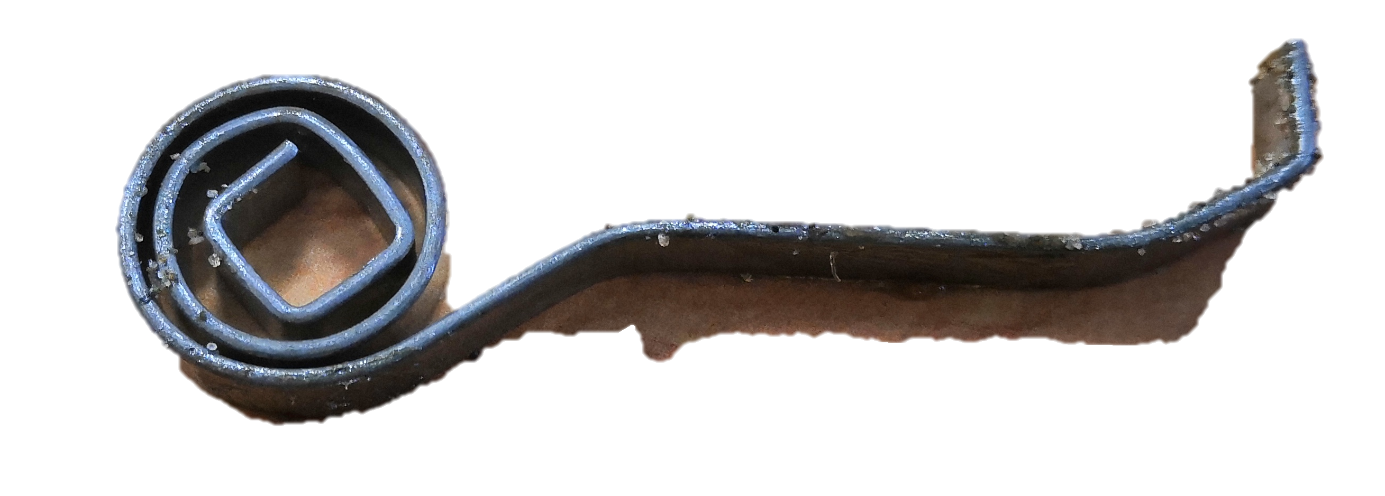
Material Passport - Part
Material properties
Part: Spring
How does it feel? Lightweight and smooth.
From assembly: Door Lock
Mass: 2.0 gram
How does it smell? It has no scent.
Material(s): some sort of metal
What is the finishing? (paint, coating) .
Value (emotional):
What is the (emotional) value?
Draw part (or cross-section):
Any specifications on the material? (code, location)
Where did the raw material come from?
What are the characteristics? (water/heat/UV/salt resistance)
Is there a risk in reusing/working with the material?
Yes
No
If yes, what is the risk? If we cut the material, it could lose its tension and thus not function as a spring anymore.
Material uniqueness
What are the unique technical/experimental qualities to be emphasized in the final application? It can be used as a spring and can be used as a
In what context would the material make the most positive difference? To keep using it as a spring in a mechanism.
How would the material then be sensed and interpreted by the users? A rolled up piece of metal.
How is the part processed at the end of its lifetime? What are the costs?
Are there any more particularities?
Some questions are based on Material Driven Design (MDD): A Method to Design for Material Experiences by Elvin Karana
This work is licensed under the Creative Commons Attribution-Share Alike 3.0 Unported License

Slide 6
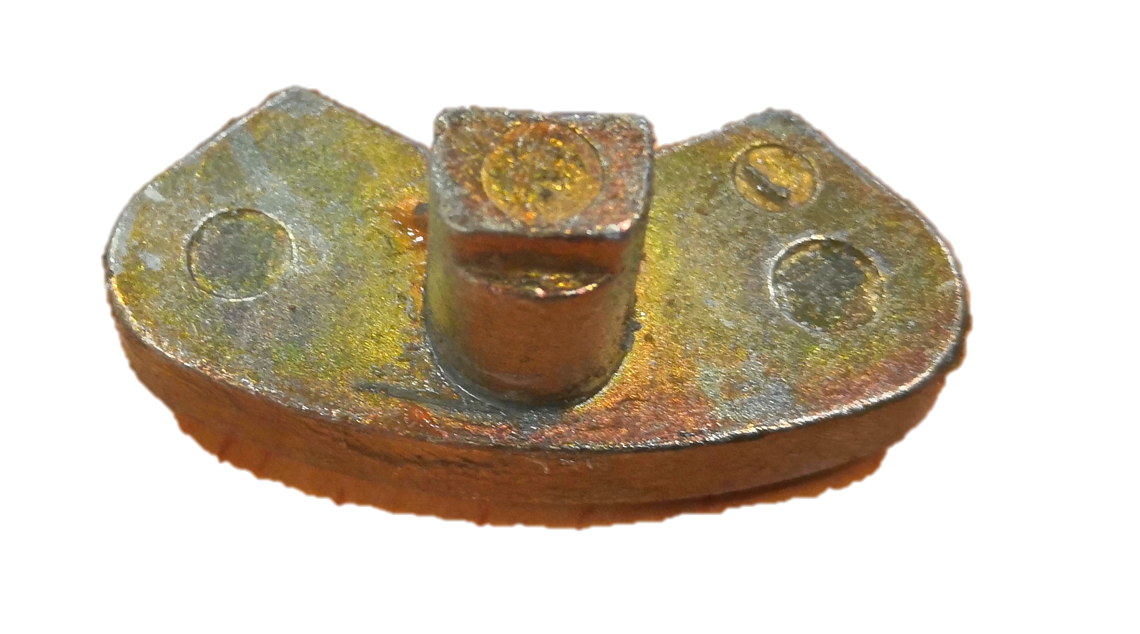
Material Passport - Part
Material properties
Part: Lock Remove
How does it feel? It is small in size with a smooth finish
From assembly: Door Lock
Mass: 1.3 gram
How does it smell? Metallic
Material(s): Aluminium
What is the finishing? (paint, coating) .
Value (emotional): It is an essential part of the locking mechanism.
What is the (emotional) value? It is an essential part of the locking mechanism.
Draw part (or cross-section):
Any specifications on the material? (code, location)
Where did the raw material come from? ...……………………………….……………... ………………………………………………………………………………………………………………...
What are the characteristics? (water/heat/UV/salt resistance) Wool has a low thermal conductivity, therefore, woolen fabrics are characterized by high heat-shielding properties
Yes
No
Is there a risk in reusing/working with the material?
If yes, what is the risk?
Material uniqueness
What are the unique technical/experimental qualities to be emphasized in the final application?
In what context would the material make the most positive difference?
Probable as is in its original lock. Or is should be melted down if it’s aluminium, because the process of aluminium takes a lot of energy.
How is the part processed at the end of its lifetime? What are the costs?
How would the material then be sensed and interpreted by the users?
Are there any more particularities? ………………………………………………………….
Some questions are based on Material Driven Design (MDD): A Method to Design for Material Experiences by Elvin Karana
This work is licensed under the Creative Commons Attribution-Share Alike 3.0 Unported License

Slide 7
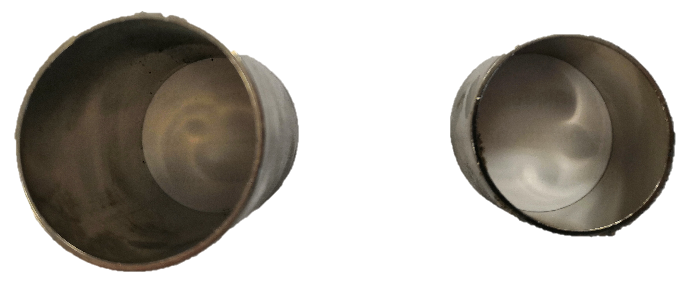
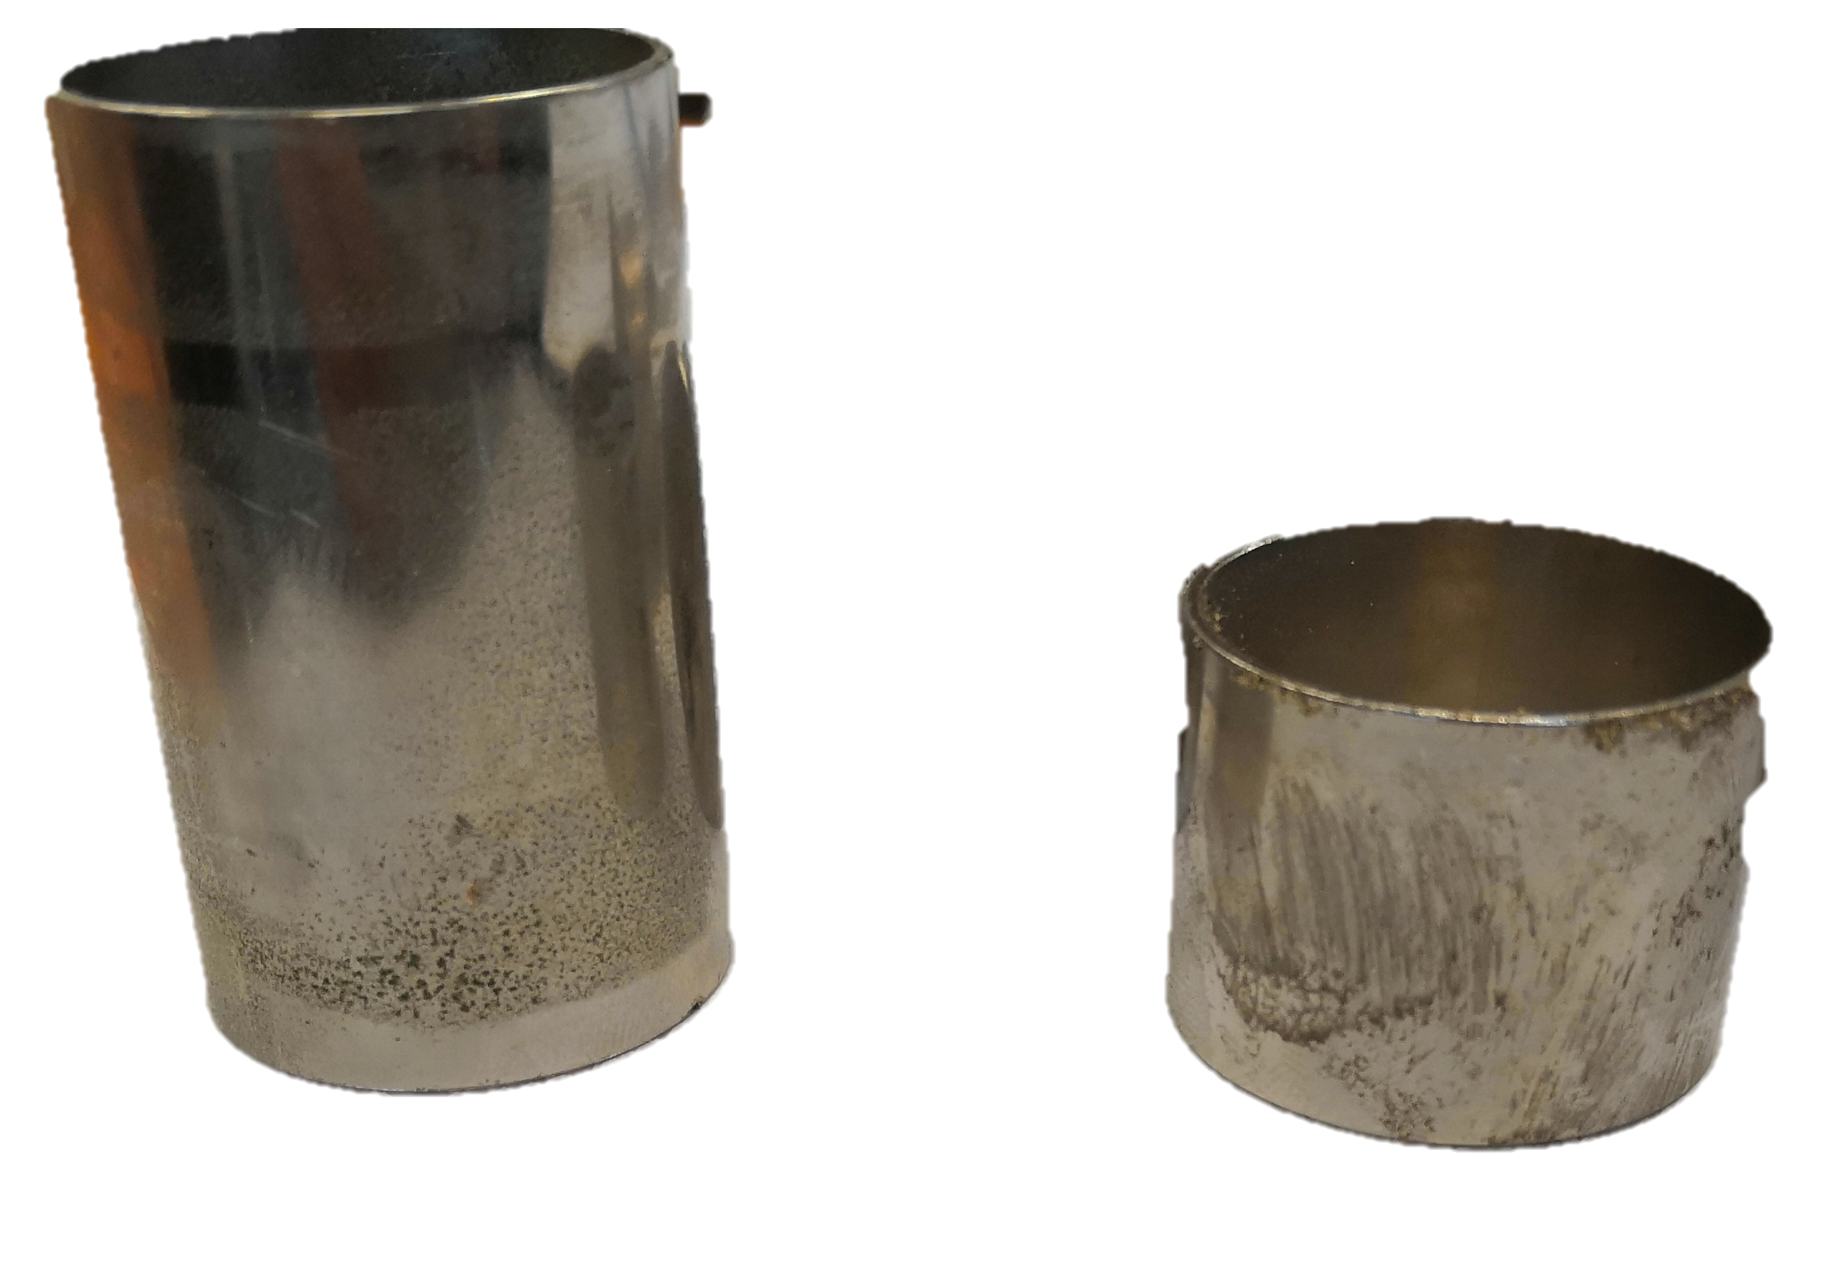
Material Passport - Part
Material properties
Part: Cylinder
How does it feel? Smooth
From assembly: Door Lock
Mass: 48 gram
How does it smell? It smells of rusted steel.
Material(s): Stainless steel that looks like it has a chrome coating
What is the finishing? (paint, coating) Chrome coated.
Value (emotional): It’s shiny and appealing to the sight
What is the (emotional) value? It is shiny and appealing to sight.
Draw part (or cross-section):
Any specifications on the material? (code, location)
Where did the raw material come from? ...……………………………….……………... ………………………………………………………………………………………………………………...
What are the characteristics? (water/heat/UV/salt resistance) Heat resistant and coated for visual aesthetics.
Yes
No
Is there a risk in reusing/working with the material?
If yes, what is the risk?
Material uniqueness
What are the unique technical/experimental qualities to be emphasized in the final application?
In what context would the material make the most positive difference? It could be repurposed as a household item (napkin holder).
How is the part processed at the end of its lifetime? What are the costs?
How would the material then be sensed and interpreted by the users?
Simple cylinder open to interpretation.
Are there any more particularities? ………………………………………………………….
Some questions are based on Material Driven Design (MDD): A Method to Design for Material Experiences by Elvin Karana
This work is licensed under the Creative Commons Attribution-Share Alike 3.0 Unported License

